Slide 1
The Human Eye and the Colorful World Part 2 :power of accommodation
CHAPTER NUMBER 11
Notes:
Welcome to the second part of chapter 11
Topic that we will cover is :
power of accommodation

Slide 2
POWER OF ACCOMODATION
Ciliary muscles.
Working of ciliary muscles.
Accommodation using ciliary muscles
Notes:
adjusting curvature so as to change the focal length so that the inverted image formed on the retina is perfect is done by the ciliary muscles
When the muscles are relaxed, the lens becomes thin. Thus, its focal length increases. This enables us to see distant objects clearly
the ciliary muscles contract. This increases the curvature of the eye lens. The eye lens then becomes thicker. Consequently, the focal length of the eye lens decreases. This enables us to see nearby objects clearly.
You may note here a normal eye can see objects clearly that are between 25 cm and infinity.
the crystalline lens of people at old age becomes milky and cloudy. This condition is called cataract. This causes partial or complete loss of vision. It is possible to restore vision through a cataract surgery.

Slide 3
DEFECTS OF VISION AND THEIR CORRECTION
How do defects happen?
blurry vision
Mainly there are 3 defects of eye:
(i) myopia or near-sightedness
(ii) Hypermetropia or farsightedness
(iii) Presbyopia
Notes:
When a person looses power of accommodation he cant see objects distinctly and comfortably.
The vision becomes blurred due to the refractive defects of the eye

Slide 4
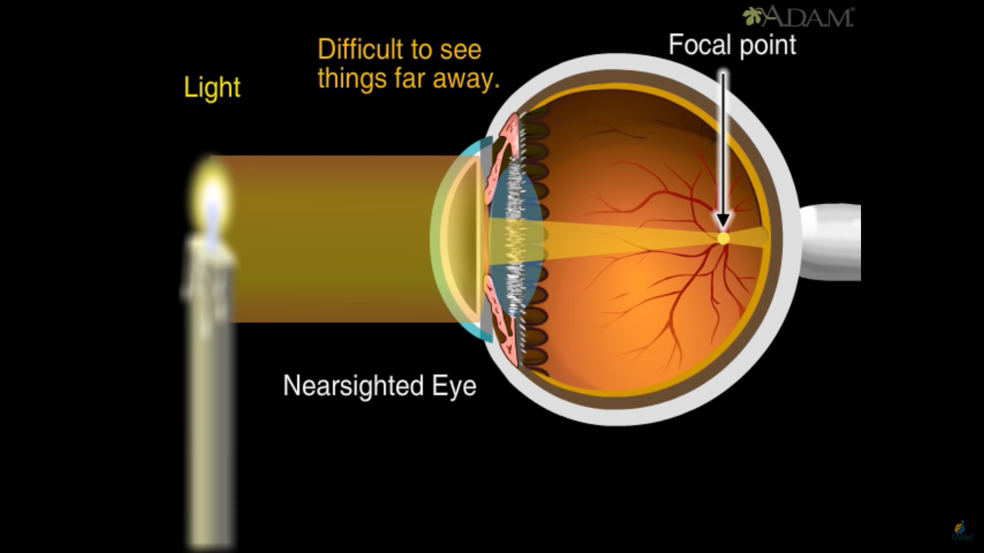
MYOPIA
Near-sightedness
How does myopia happen?
Notes:
Myopia is also known as near-sightedness.
A person with myopia can see nearby objects clearly but cannot see distant objects distinctly.
A person with this defect has the far point nearer than infinity.
The Animation:
The light travels through lens and is suppose to fall on retina but instead of that happening the light rays converge before the retina wall.
this might happen due to the length of curvature wall has increased.

Slide 5
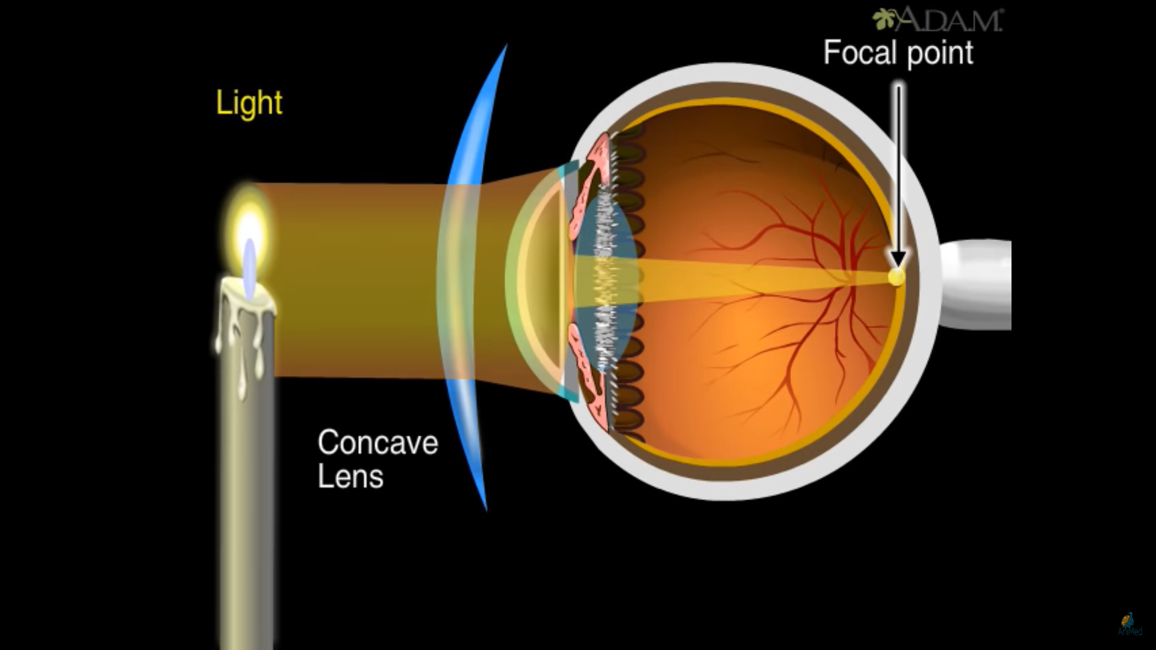
Fixing myopia
Notes:
Myopia can be corrected with eyeglasses , contact lenses or refractive surgery. Depending on the degree of your myopia, you may need to wear your glasses or contact lenses all the time or only when you need very clear distance vision
Treatments that can be given: Refractive surgery; Glasses; Contact lens

Slide 6
Fixing myopia

Slide 7
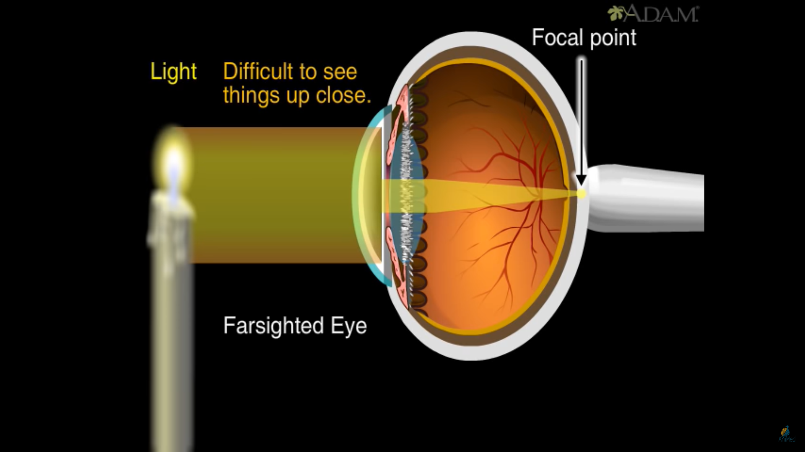
Hypermetropia
Far-sightedness.
How does Hypermetropia
happen?
Notes:
Hypermetropia is also known as far-sightedness
A person with hypermetropia can see distant objects clearly but cannot see nearby objects distinctly.
The near point, for the person, is farther away from the normal near point (25 cm). Such a person has to keep
a reading material much beyond 25 cm from the eye for comfortable reading.
This is because the light rays from a close by object are focused at a point behind the retina. This defect arises either because the focal length of the eye lens is too long, or the eyeball has become too small.

Slide 8
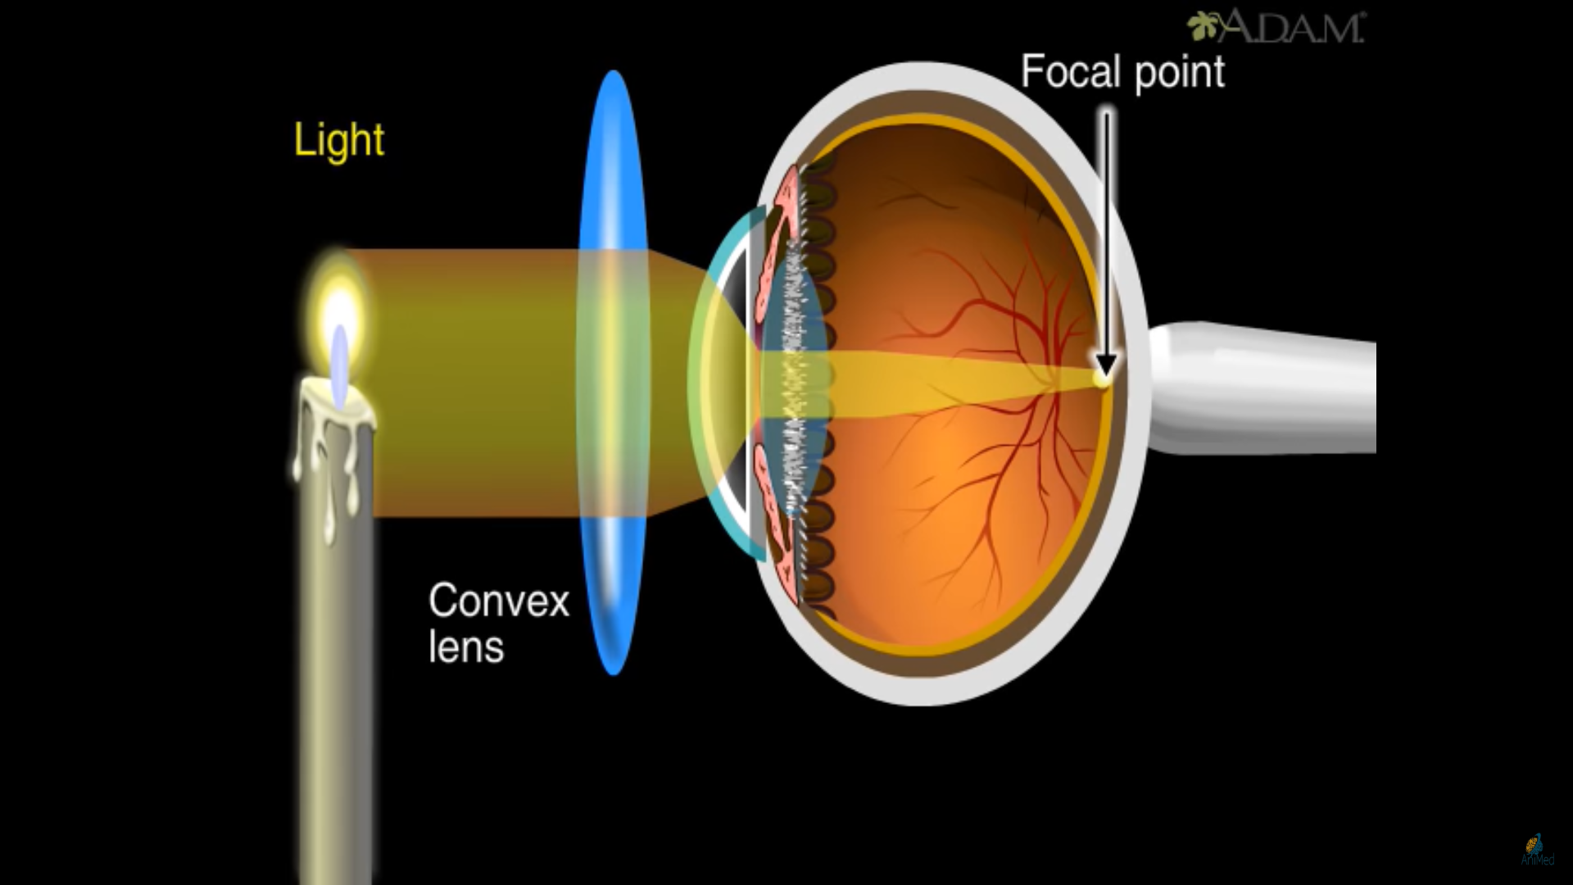
Fixing hypermetropia
Notes:
This is because the light rays from a close by object are focused at a point behind the retina.
This defect arises either because the focal length of the eye lens is too long, or the eyeball has become too small.
Farsightedness can be corrected with glasses or contact lenses to change the way light rays bend into the eyes. If your glasses or contact lens prescription begins with plus numbers, like +2.50, you are farsighted.

Slide 9
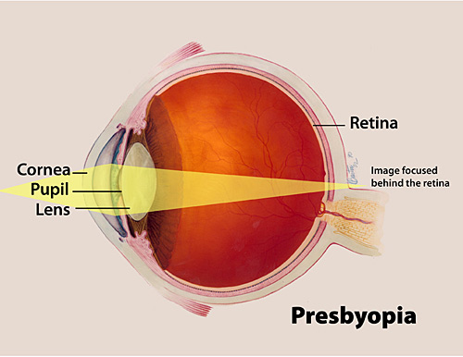
PRESBYOPIA
What is presbyopia?
What is the reason ?
Fixing presbyopia.
Notes:
For most people, the near point gradually recedes away. They find it difficult to see nearby objects comfortably and distinctly without corrective eye-glasses. This defect is called Presbyopia
It arises due to the gradual weakening of the ciliary muscles and diminishing flexibility of the eye lens
Sometimes, a person may suffer from both myopia and hypermetropia. Such people often require bi-focal lenses. A common type of bi-focal lenses consists of both concave and convex lenses. The upper portion consists of a concave lens. It facilitates distant vision. The lower part is a convex lens. It facilitates near vision.

